Slide 1

Case Study House Data
Adil Ahmed

Slide 2
Houses are one of the necessary need of each and every person around the globe
Housing and real estate market is one of the markets which is one of the major contributors in the world economy
It is very large Market that various companies working in that domain

Slide 3
Role of Data Science
Data science comes as a very important tool to solve the problem in the domain.
To increase their overall revenues, profit improving their marketing statergies and focusing on changing trends in house sale and purchase

Slide 4
Use Case :
To predict the pricing of the house based :
Acres( How Many acres it spread)
Bedrooms (Number of Bedrooms)
Bathroom
Garage(Availability of Parking Area/ Garage)
Kitchen Features( Availability of Kitchen Items)
Fireplaces
Floor Covering and Many more
And Many features which direct depends on the price of the House

Slide 5
House Price prediction
To Predict the housing price we need to create Machine Learning Model.
To Create a Machine Model we need Data
Data Collection:
Extracting data from different sources where you can easily create a Machine Learning Model to predict Housing Price
Data collection is very important task for predicting any Machine Learning Model
We Have housing Price Data as per United States Market

Slide 6
Importing Libraries
Required Libraries importing into the system
NumPy Numerical Python used for numerical and statistical data
Pandas used for categorical data and to insert the dataset into system
Seaborn used for data visualization
Matplotlib used to plotting the graphs

Slide 7
EDA(Exploratory Data Analysis) To Analyze and Investigate Dataset and summarize their main Characteristics
In this Data set perform EDA on features to check any Missing values are there Incorrect data or any other outiers available
After Performing EDA we find that some of the features having missing values
Lot_acres
Area(Sqrt.ft)
Kitchen_Feature
Garage
Bathrooms
Fireplace#
Floor_Covering
HOA

Slide 8
After Checking the missing values we perform some operations on the missing values
Missing Values contains Numerical Data i,e Integer or Float and Character Data i,e String
For Integer and float value we add mean value of the current column on missing values
For Character Value we add mode value of the current column on the missing value.
After adding missing value we need to convert the string data into numerical data using ASCI Code
Object data need to convert into numerical because the use case is to perform the
House pricing which is numerical data so we need to convert each string data into numerical data
To convert string into numerical data using ASCII code
Each word contains its different ASCII code based on that code it will convert into Numerical data

Slide 9
Data Visualization why visualization is important?
To check whether the data is Normalized or not
To check the relationship between features and the Targer Variables
To check if the data contains any outliers or not
To check with feature is important to predict the price of housing (Feature Selection)

Slide 10
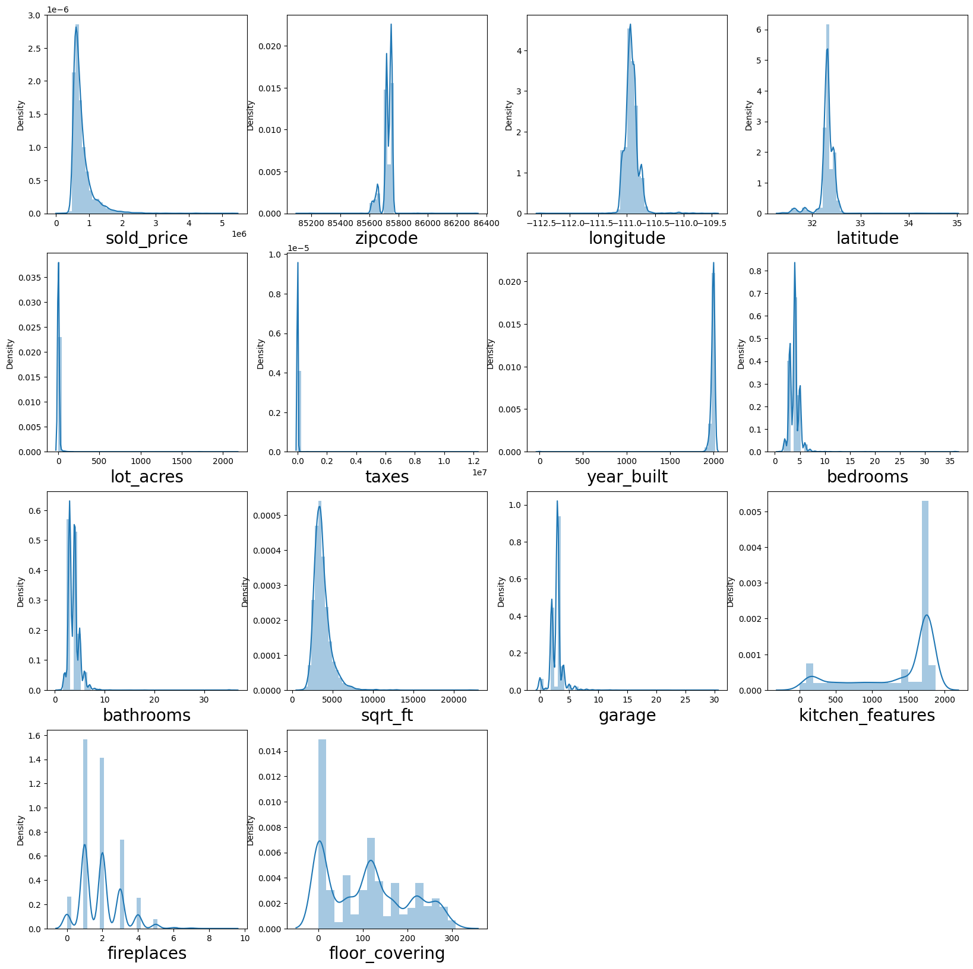
Data Normalization
For every Regression Problem i,e Numerical data we need to check whether all the features are normalized or not to check Data Normalization we used distribution Plot
Distribution plot used to check whether each feature is distributed Normally or not
Using Distribution plot we check the data is Normalized.

Slide 11
Feature Selection
Feature selection is very important task to create any Machine Learning Model
To Select the feature in such a way that the target value directly depend on the feature
If the Features values got increased the target values also increased
If the Features got decreased the targeted value will also decreased
Easy way to find the best feature for targeted value is the scatter plot
Scatter plot shows how the targeted value and features are plotted on graph

